Slide 1

Job_init_
DESIGN-ATHON
Team name : Trouble Trio
Job_init_
Team :
Nikitha Naidu
Saumya Gupta
Richal Pandey
A career go-to destination

Slide 2

Theme
A platform which connects multiple organizational stakeholders to help students find matching jobs for their profile

Slide 3




Job_init_
Job _init_ is focused on being a mediator between jobs provided by companies and college students
Job _init_ is a platform where students can post their profile/resume and the app will display jobs matching to their profiles
Students can search for different jobs and apply for them using this platform then companies can contact them based on the position required
Faculty can view the active students on the platform and their matching jobs and guide those students for a better future

Slide 4




SPOCs and placement officers can register on this platform, make a college profile and maintain them and they can help students by informing them about new opportunities.
Students looking for colleges can view the college profiles maintain by SPOC or placement officers
Students can review a company after the internship/job which will be helpful for other students before applying for a job to a company
Students can take mentoring from faculty about the job/internship which is lacking in today's world by using the chat option

Slide 5

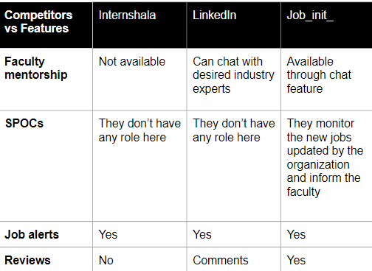
The Competition
Our major competition is the existing job searching platforms which has already established their name in the market and which are widely used.

Slide 6
Grabbing our audience by launching our app in several universities under the guidance of Placement officers and also by charging it.
SEOs tend to add value to our company as they reach a larger audience.
Social media- Instagram, Facebook etc and radio, newspaper advertisements.
Implementing premium membership for special value added services to all kinds of roles
Market Strategy

Slide 7

Investment
We would require a plug and play workspace which would cost us
about 20,000(monthly recurring cost) .
The initial capital required is about 3,00,000 for the physical setup
in the workspace like desktops, printers, Wi-Fi connection, electricity etc.
We, the partners, will be investing 1,00,000 each and the rest of the amount will be taken as loan from the bank for which we pay an EMI of 12,000.

Slide 8

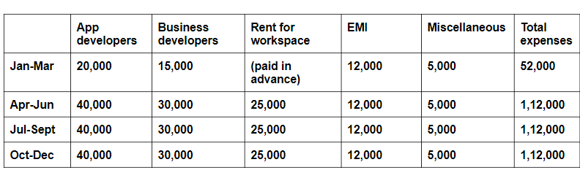
FINANCIAL PLAN FOR THE FIRST YEAR

Slide 9

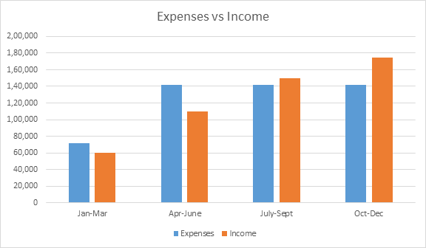
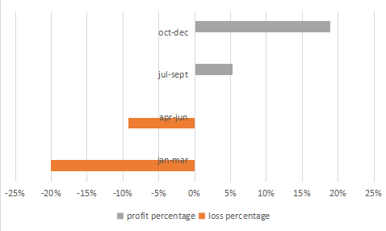
Expenses vs income
Profit vs Loss

Slide 10



APP WORKFLOW
Registration
Placement officer/SPOC's
Student
Organization/Company
Faculty
Shows matching jobs
Post jobs/internships
Contact Applicants
Can see how many students are active on the platform
Mentoring students about jobs/internships and prepare students for interviews
Maintain college profile
Can update students about new opportunities
Contact faculty for mentoring through chat option
Apply for jobs/internships
Hire Applicants
Can see how many students have registered on the platform

Slide 11

Thank You

